Slide 1
Retail Store Demand Forecasting
Using Random Forest and Gradient Boosting

Slide 2
Introduction:
Business problem: Develop a demand forecasting model for a retail store chain that can predict future sales for each product category and store location. The model should incorporate factors like past sales data, promotions, holidays, and demographic information.
Business Objective: To predict future sales for each category and store location.
Business Constraint: Maximize the sales for each category and store location
Success Criteria
Business Success Criteria: Increased sales, improved customer satisfaction, and optimized inventory management.
Machine Learning Success Criteria: Achieve an accuracy Atleast 95%
Economic Success Criteria: Positive return on investment (ROI) and reduced inventory costs.

Slide 3
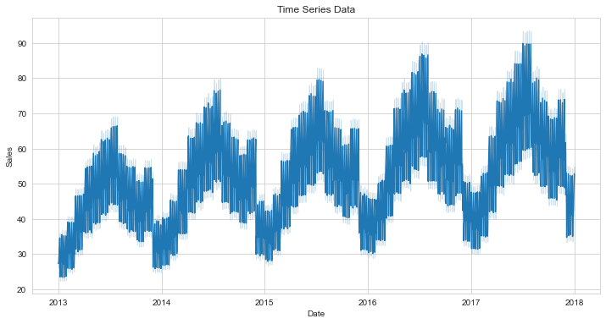
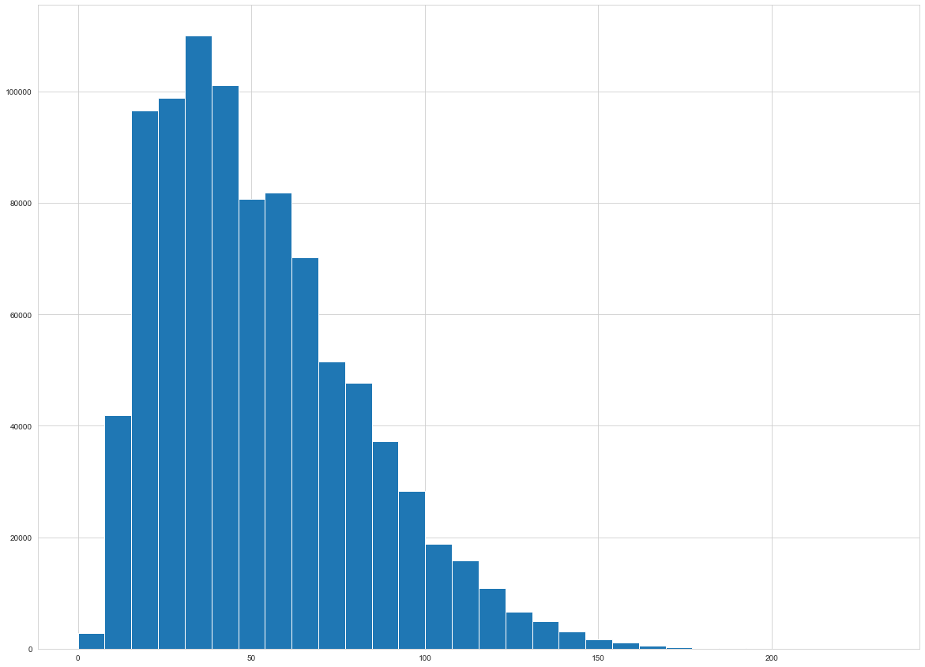
Data Exploration and Preprocessing
1. Data Exploration:
- Histogram for Sales:
- Displayed the distribution of sales, showing a range of sales values with some noticeable peaks.
- Histograms for Items and Stores:
- Items: Each of the 50 item categories is uniformly distributed.
- Stores: Each of the 10 stores shows a similar distribution of data points.
- Time Series Plot:
- Visualized sales over time, showing trends, seasonality, and potential outliers.
2. Box Plots:
- Sales Box Plot:
- Showed the spread and outliers in the sales data.
- Item and Store Box Plots:
- Highlighted the distribution of sales across different items and stores.
3. Feature Engineering:
- Date Transformation:
- Converted the `date` column to datetime type.
- Extracted features: year, month, day, day of the week, day of the year, and week of the year.
- Lagged Features:
- Created lagged features for sales (sales_lag_1 to sales_lag_7).
4. Data Preprocessing:
- Handling Missing Values:
- Filled NaN values in lagged features with the median value.
- Categorical Encoding:
- Converted `item` and `store` columns to categorical types and applied one-hot encoding.

Slide 4
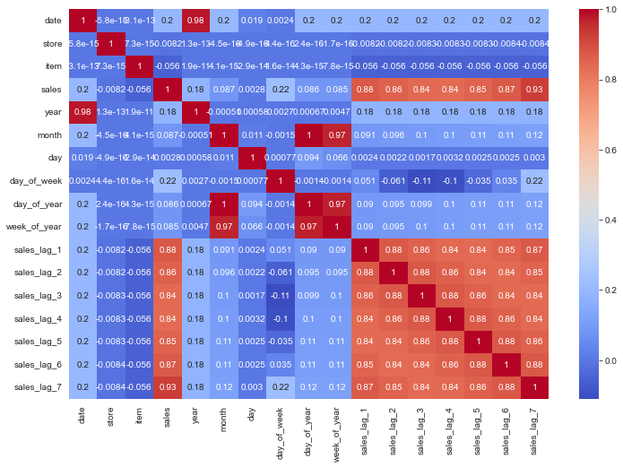
Model Building and Evaluation
1. Model Description:
- Random Forest Regressor:
- Used to capture complex interactions between features.
- Gradient Boosting Regressor:
- Applied to improve prediction accuracy through boosting.
2. Model Training:
- Split data into training and test sets.
- Trained models using sales as the target variable.
3. Evaluation Metrics:
- Root Mean Squared Error (RMSE):
- Random Forest Train RMSE: 3.01
- Random Forest Test RMSE: 6.32
- Gradient Boosting Train RMSE: 8.10
- Gradient Boosting Test RMSE: 4.57
4. Model Performance:
- Random Forest showed a slightly higher RMSE on the test set compared to Gradient Boosting.
- Gradient Boosting performed better on the training set, indicating it may handle overfitting more effectively.
5. Visualization:
- Correlation matrix heatmap showing feature correlations.
- Time series plot of predicted vs. actual sales to visualize model performance.

